Slide 1

COCOQUEST 2026 · THEME 1
Agentic Data Quality Guardian
It finds messy data, proposes fixes, and applies them safely, only after a human says yes.
Snowflake
Streamlit
Cortex AI
CoCo
[Bimal Pattnaik] · [Binayak Ransigh] . [Shubha Prasad Mohanty]
Notes:
Open with the one-line idea: an agent that finds messy data in Snowflake, proposes fixes, and applies them only after a human approves. Mention it is built for CoCoQuest Theme 1 and runs entirely inside Snowflake. Say your name and team.

Slide 2
Messy data breaks reports, deliveries and trust
What is in the table | What is wrong | What it breaks
ravi.example.com | No @ sign in the email | Marketing emails bounce
+91-98765 43210 | Phone typed in another format | SMS delivery fails
ODISHA next to Odisha | Same state, two spellings | One region shows up as two
The same customer, twice | Exact duplicate row | Revenue is counted twice
Order for customer 900127 | That customer does not exist | Joins and dashboards break
Shipped before ordered | Impossible date | Delivery metrics are wrong
Real tables have thousands of these problems, and checking them by hand does not scale.
Agentic Data Quality Guardian · CoCoQuest 2026
Notes:
Set the scene with concrete examples every business recognises: a bad email, an odd phone format, two spellings of one state, a duplicate customer, an order for a customer that does not exist, and an impossible date. Each one silently breaks something downstream. Then land the point: nobody can check millions of rows by hand.

Slide 3






One agent loop, with a human in control
Discover
Scan
Propose
Profiles every column and writes its own quality rules.
Runs the rules, finds the bad rows and scores the table from 0 to 100.
Recipes and Cortex AI draft a fix for every failing rule.
Approve
Apply and verify
Audit
You review the SQL, edit it if needed, and tick approve.
Fixes run on a sandbox copy, then the table is scanned again.
Who changed what, how many rows, before and after.
Agentic Data Quality Guardian · CoCoQuest 2026
Notes:
Walk the six steps left to right. The key phrase is human in control: the agent discovers, scans and proposes, but nothing changes until a person approves, and even then the change lands on a copy, not the original. Everything is recorded in an audit log.

Slide 4





Five pages, one workflow
Dashboard
Scan
Fix Studio
CoCo Assist
Audit
Scores, trends and every table you have scanned.
Discover rules, add your own, run the scan, read the AI briefing.
Review, edit and approve fixes, apply to the sandbox, compare before and after.
Builds a ready-made prompt to hand hard cases to CoCo.
Every change with user, role, SQL and row counts.
Sidebar controls: pick the table, choose the Cortex model, and set how strict the scoring is.
Agentic Data Quality Guardian · CoCoQuest 2026
Notes:
Introduce the app as five pages that follow the loop. Dashboard shows the state of all guarded tables. Scan is where rules are discovered and the scan runs. Fix Studio is where a human reviews and approves. CoCo Assist hands hard cases to CoCo. Audit shows the history.

Slide 5



Everything runs inside Snowflake
DQ_GUARDIAN database
RAW
Source tables. Never modified.
Cortex AI
You, in Snowsight
CLEAN
AI_COMPLETE writes fix SQL and the plain-language briefing.
Streamlit app with five pages.
Sandbox clones where fixes are applied.
CoCo panel for hard cases and reviews.
DQ
Runs inside Snowflake, so data stays put.
Rules, scan results, proposals and the audit log.
Compute: a single XSMALL warehouse that suspends itself after 60 seconds.
Agentic Data Quality Guardian · CoCoQuest 2026
Notes:
One picture of the architecture. The user works in Snowsight. Data lives in a database called DQ_GUARDIAN with three schemas: RAW for the source tables, CLEAN for sandbox copies, and DQ for the guardian's memory. Cortex AI is called with SQL functions, so no data leaves Snowflake.

Slide 6
It writes its own quality rules
Rule type | Example the app creates
Completeness | EMAIL must not be blank
Format | PHONE is a 10-digit Indian mobile number
Valid values | STATE: Odisha is valid, ODISHA is flagged
Dates and ranges | Birth date is not in the future
Outliers | CREDIT_LIMIT far outside the normal spread
Uniqueness | CUSTOMER_ID is unique, no duplicate rows
Links between tables | ORDERS.CUSTOMER_ID exists in CUSTOMERS
Your own rule | SHIP_DATE is not before ORDER_DATE
36
rules created on the CUSTOMERS demo table
25
rules created on the ORDERS demo table
Includes 3 hand-written business rules. Rules can be switched off, re-rated or added.
Agentic Data Quality Guardian · CoCoQuest 2026
Notes:
The app profiles each column and generates rules from column names, data types and value frequencies. No configuration. It even infers that ORDERS.CUSTOMER_ID should exist in CUSTOMERS. On our demo tables it created 36 and 25 rules. Business logic that cannot be inferred, such as ship date not before order date, is added as a custom rule.

Slide 7
Every table gets a health score
CUSTOMERS, before fixes
Quality by dimension
85.3
Validity
77.5
Uniqueness
80.4
Consistency
82.1
health score out of 100
Completeness
92.5
1,753 of 5,100 rows have at least one issue
Accuracy
96.5
rule score = 1 - (share of bad rows x strictness)
Agentic Data Quality Guardian · CoCoQuest 2026
Notes:
Explain the score. Each rule gets a mini score: one minus the share of bad rows multiplied by a strictness setting. High severity rules count three times, medium two, low once. The strictness slider exists because most rules pass, so a plain average would make dirty data look clean. The bars show the customer table by quality dimension. Validity and uniqueness are the weakest.

Slide 8
Three sources of fixes, always reviewed
18
2
4
Ready-made recipes
Written by Cortex AI
Left for people
Trim spaces, remove duplicates, standardise spelling, normalise phone numbers. Same input, same output, easy to explain.
Custom business rules such as signed up before age 18. The guardrail checks the SQL before you see it.
Missing values and outliers are never guessed. The app explains why a human must decide.
LOW: safe clean-up
MEDIUM: changes values
HIGH: deletes rows
Counts from the test run on both demo tables.
Agentic Data Quality Guardian · CoCoQuest 2026
Notes:
Every failing rule gets a proposal. Well-understood problems use deterministic recipes, which are explainable and repeatable. Rules without a recipe, such as custom business rules, are sent to Cortex AI, and its SQL must pass the guardrail. Problems that cannot be fixed without guessing are left for a human. Each proposal carries a risk colour: green is safe clean-up, orange changes values, red deletes rows.

Slide 9






Safe by design
Source is never touched
A human approves every change
SQL guardrail
Fixes run on a zero-copy clone in the CLEAN schema.
Only UPDATE, DELETE and CREATE OR REPLACE TABLE on the sandbox table.
Nothing runs until someone ticks approve.
AI treated as untrusted
Data stays in Snowflake
Full audit trail
Table values are marked as data, not instructions.
Cortex AI runs inside the platform.
User, role, SQL, rows changed, before and after.
6 of 6 hostile AI answers were blocked in testing.
Agentic Data Quality Guardian · CoCoQuest 2026
Notes:
This is the responsible AI slide. The original table is never modified. A human approves each change. All SQL, whether written by a template, by AI, or edited by a person, passes a guardrail. AI is treated as untrusted: values from the table are labelled as data in the prompt. In testing we fed the app six hostile AI answers, including DROP, GRANT, TRUNCATE, writes to the raw table and comment tricks, and all six were blocked.

Slide 10
The guardrail in action
Allowed
Blocked
UPDATE CLEAN.CUSTOMERS SET ...
DROP TABLE ...
DELETE FROM CLEAN.ORDERS WHERE ...
Not an allowed statement
CREATE OR REPLACE TABLE CLEAN.CUSTOMERS AS SELECT ...
UPDATE RAW.ORDERS SET ...
The source table is protected
Only on the sandbox copy of the table being fixed.
UPDATE ...; GRANT ALL ...
Forbidden keyword in a chained statement
-- harmless comment
Comments are not allowed
Checked when a fix is generated, when you edit it, and again at the moment it runs. Names are shortened here for readability.
Agentic Data Quality Guardian · CoCoQuest 2026
Notes:
Show concretely what the guardrail does. Allowed: UPDATE, DELETE, or create-or-replace-table-as-select, and only on the sandbox copy. Blocked: DROP, writes to the source table, chained statements containing GRANT, and comments. It runs three times: at generation, when a human edits the SQL, and at the moment of execution. In the live demo, type DROP TABLE into a fix and show the red message.

Slide 11

Apply to the sandbox, then prove it worked
CUSTOMERS health score
Before
After
85.3
93.0
Validity
77.5
100.0
Uniqueness
80.4
Rows: 5,100 to 5,000 (100 duplicates removed)
100.0
Rows with issues: 1,753 to 880
Consistency
82.1
100.0
Failing rules: 18 to 7
Completeness
92.5
82.8
Accuracy
96.5
96.4
Completeness dips because impossible values are emptied, never invented. The trade-off is shown, not hidden.
Agentic Data Quality Guardian · CoCoQuest 2026
Notes:
Approved fixes run on the sandbox copy and the table is scanned again with the same rules. On the customer table the score moves from 85.3 to 93.0. Validity, uniqueness and consistency reach 100. Be upfront about the honest trade-off: completeness goes down from 92.5 to 82.8, because we empty impossible values instead of guessing them. We prefer empty over wrong.

Slide 12
Results on the demo data
Table | Health score | Failing rules | Rows
CUSTOMERS | 85.3 to 93.0 | 18 to 7 | 5,100 to 5,000
ORDERS | 96.4 to 98.4 | 10 to 7 | 12,000 to 11,906
20
94
fixes applied, and all 20 recorded in the audit log
orphan orders removed by the one HIGH-risk fix, which a reviewer approves deliberately
Test run with every proposed fix approved. Your numbers will be close, not identical.
Agentic Data Quality Guardian · CoCoQuest 2026
Notes:
Give the headline numbers from the test run. Customers improve from 85.3 to 93.0 and orders from 96.4 to 98.4, with failing rules dropping from 18 to 7 and from 10 to 7. Twenty fixes were applied and all twenty are in the audit log. The 94 removed orders are the orphan rows, the one high-risk fix, which a reviewer would normally look at first. Remind the audience that these were test runs and live numbers will be close but not identical.

Slide 13

Every change leaves a trace
Who ran it: user and role
What ran: the exact SQL
How many rows changed
Row counts before and after
When it happened
Which proposal it belonged to
PROPOSED
APPLIED
FAILED
BLOCKED
Two plain SQL tables, FIX_AUDIT_LOG and FIX_PROPOSALS, so anyone can query the history.
Agentic Data Quality Guardian · CoCoQuest 2026
Notes:
Governance slide. Every applied fix writes a row: who, which role, what SQL, how many rows changed, and row counts before and after. Proposals keep a status so you can see what was suggested, applied, failed or blocked by the guardrail. Because it is just tables, auditors can query it with SQL.

Slide 14
CoCo in three roles
1
2
3
Build time
Hand-off from the app
Inside the app
Explore the account, review the code, red-team the guardrail and extend the app. The prompts are in COCO_PROMPTS.md.
The CoCo Assist page turns the live scan into a prompt. CoCo inspects the sandbox and proposes SQL under your own permissions.
Cortex AI writes fix SQL for custom rules and the plain-language briefing for business owners.
CoCo is an interactive agent, so the link is a deliberate hand-off with a human in charge. Open it from the icon at the bottom-right of Snowsight.
Agentic Data Quality Guardian · CoCoQuest 2026
Notes:
Be precise about how CoCo is used. One: at build time, CoCo explores the database, reviews the code and red-teams the guardrail. Two: at run time, the CoCo Assist page generates a prompt from the live scan, and you paste it into the CoCo panel so it can work on the sandbox under your permissions. Three: inside the app, Cortex AI functions write fix SQL and the briefing. The app does not call CoCo automatically, because CoCo is interactive by design.

Slide 15
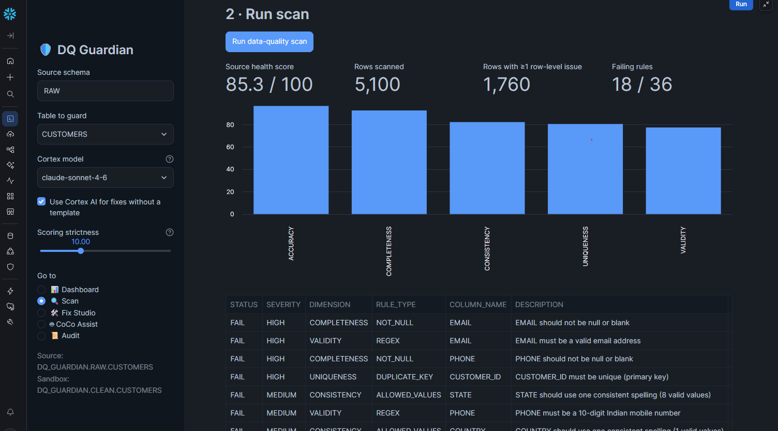
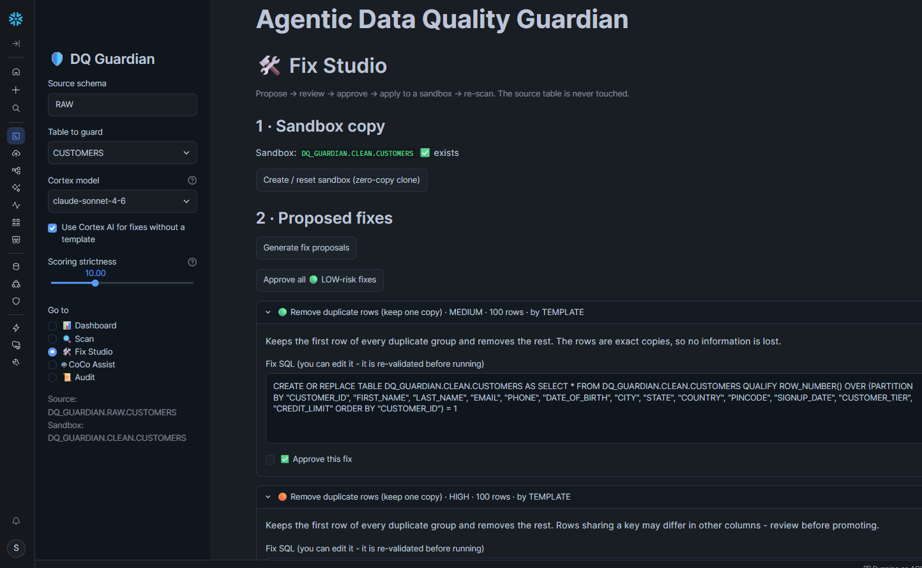
Live proof (1 of 3): scan and propose
05 · SCAN
85.3 out of 100 on the raw table
5,100 rows checked against 36 rules: 1,760 rows have an issue and 18 rules fail. Validity and uniqueness score lowest.
07 · FIX STUDIO
Each failing rule gets a reviewable fix
A sandbox clone is ready. Each card shows risk, row count, author and editable SQL with an Approve box. This one removes 100 duplicate rows.
Agentic Data Quality Guardian · CoCoQuest 2026
Notes:
Screenshots 05 and 07 from the live run on a Snowflake account. Left: the scan of the raw CUSTOMERS table scored 85.3 out of 100, checked 5,100 rows against 36 rules, found 1,760 rows with at least one issue and 18 failing rules. Right: Fix Studio with the sandbox clone ready and the first proposed fix, which removes 100 exact duplicate rows. Point out the risk colour, who wrote the fix, the editable SQL and the Approve box.

Slide 16
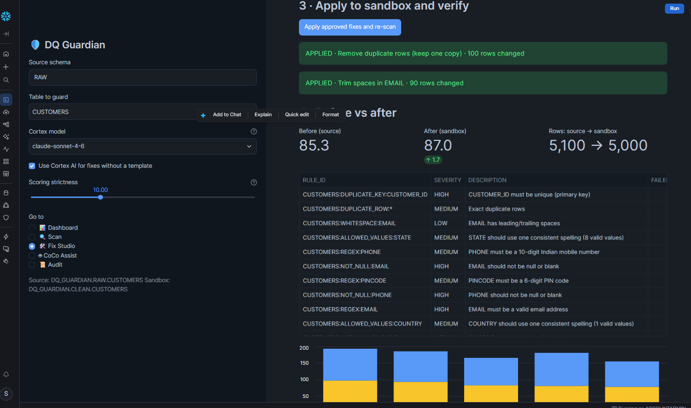
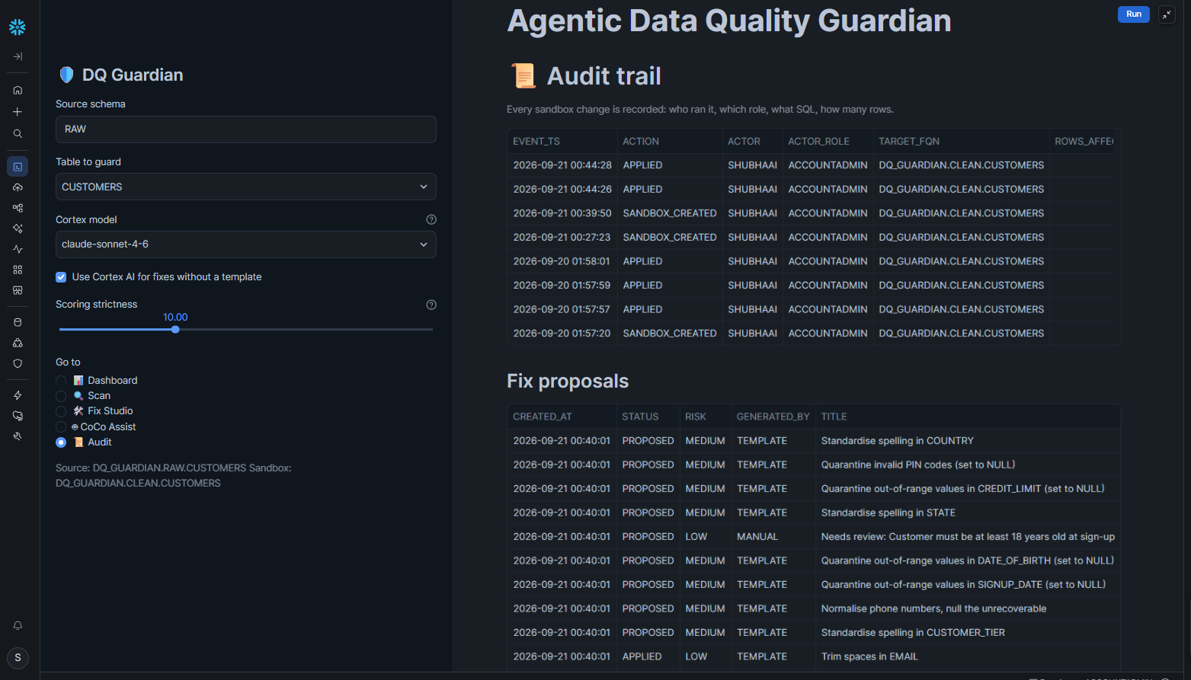
Live proof (2 of 3): apply and audit
09 · BEFORE VS AFTER
Score 85.3 to 87.0 with two fixes
Removing duplicates changed 100 rows and trimming email spaces changed 90, on the sandbox only. Rows went from 5,100 to 5,000. More approvals lift it further.
10 · AUDIT TRAIL
Every sandbox change is recorded
Time, user, Snowflake role, target table and action for each step. The proposals table keeps every fix's status, risk and author.
Agentic Data Quality Guardian · CoCoQuest 2026
Notes:
Screenshots 09 and 10. Left: two approved fixes were applied to the sandbox only. Removing duplicates changed 100 rows and trimming spaces in EMAIL changed 90. The score moved from 85.3 to 87.0 and rows from 5,100 to 5,000. In this run only two fixes were approved, so approving the other proposals lifts the score further; the earlier full test run with every fix approved reached about 93. Right: the audit trail shows time, user, role, target table and action for each step, and the proposals table keeps each fix's status, risk and author.

Slide 17
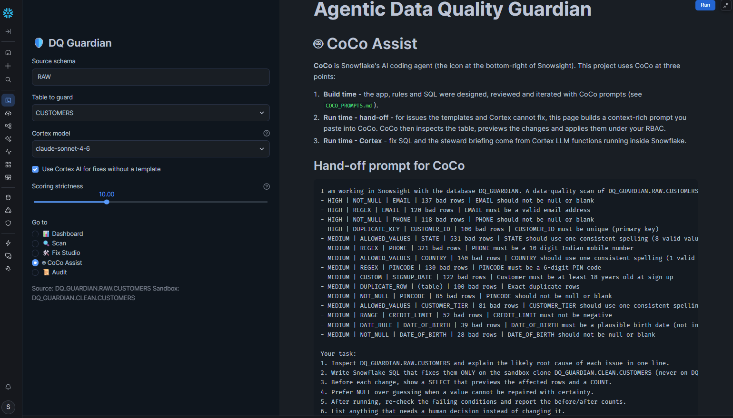
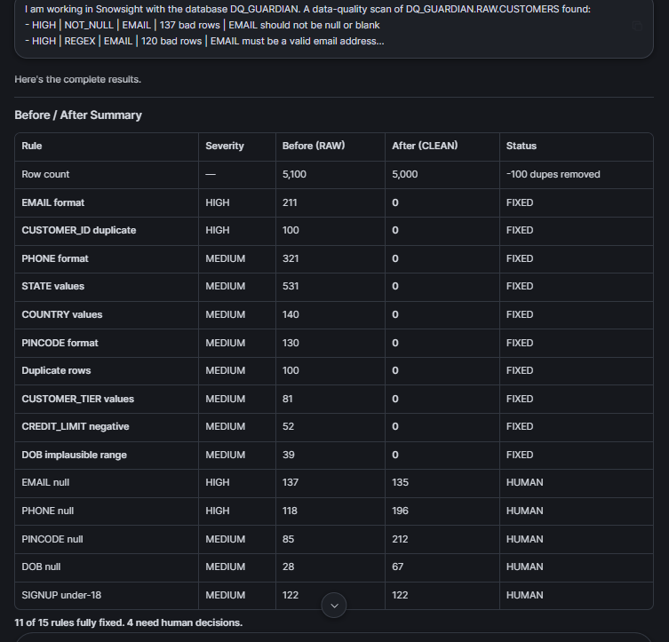
Live proof (3 of 3): hand-off to CoCo
11 / 15
rules fully fixed by CoCo
4
need a human decision
11 · COCO ASSIST
The app writes the prompt for CoCo
Built from the live scan: every failing rule with its bad-row count, the sandbox clone as the only target, and a request to preview, prefer NULL and report before and after.
12 · COCO IN SNOWSIGHT
CoCo fixed 11 of 15 rules
Its summary shows 100 duplicates removed and STATE, PHONE, COUNTRY and PINCODE checks down to zero. Four rules, such as missing values, need a human decision.
Agentic Data Quality Guardian · CoCoQuest 2026
Notes:
Screenshots 11 and 12. Left: the CoCo Assist page turns the live scan into a prompt for CoCo. It lists every failing rule with its bad-row count and tells CoCo to work only on the sandbox clone, preview changes, prefer NULL over guessing and report before and after. Right: CoCo running in Snowsight. It asked for permission before running SQL, then reported that 11 of 15 rules were fully fixed on the sandbox and 4 need human decisions, for example missing values.

Slide 18




What comes next
Scheduled scans
Turn the scan into a stored procedure and a daily Task.
Alerts
Email the owner when a table score drops below a threshold.
Freshness rules
Flag tables that have stopped updating.
Snowflake data metrics
Compare and combine with built-in data metric functions.
Promote to production
A reviewed, approved step to publish cleaned tables.
Each one has a ready-made CoCo prompt in COCO_PROMPTS.md.
Agentic Data Quality Guardian · CoCoQuest 2026
Notes:
Close the technical part with the roadmap. Scheduled scans, alerts, freshness rules, Snowflake data metric functions, and a reviewed promote-to-production step. For each of these the repository already contains a CoCo prompt, so extending the project is a matter of using CoCo, which is the point of the hackathon.

Slide 19
Clean data, with a human in charge.
Finds the mess
Fixes it safely
Proves it worked
Writes its own rules and scores every table.
Sandbox copy, guardrail, human approval.
Re-scan, before and after, full audit trail.
https://github.com/data-shubha/dq-guardian-cocoquest/
Thank you · [Bimal Pattnaik] · [Binayak Ransigh] . [Shubha Prasad Mohanty]
Notes:
Finish on the three takeaways: it finds the mess, fixes it safely, and proves it worked. Show the repository link and thank the judges. Invite questions and offer a live demo.

